Slide 1

Notes:
This is the Pre-Title Screen.
Please do not place any content on this screen.

Slide 2

Latest on SharePoint Framework – Building Microsoft 365 Solutions Using Unified Development Pattern
Sharing is caring
Notes:
To add your image, first delete the place holder image as shown in the white box. Then insert your picture and scale it to be bigger than the size of the white box shown. Finally, right click on your image and select ‘Send to back’ – your image should now be framed correctly.

Slide 3

Latest on SharePoint Framework – Building Microsoft 365 Solutions Using Unified Development Pattern

Slide 4


Slide 5

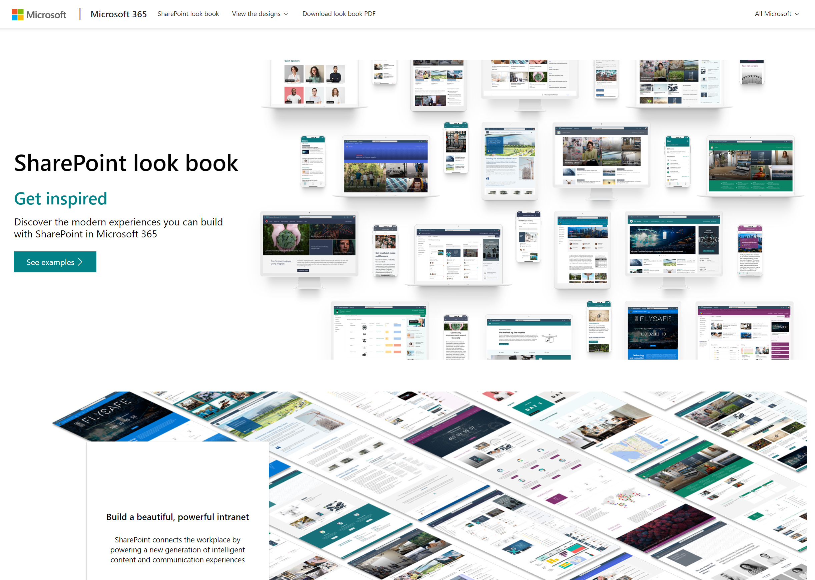


UPDATE
New SharePoint Look Book with beautiful designs and integrated provisioning
https://lookbook.microsoft.com
Notes:
Dan’s slide

Slide 6
DEMO
SharePoint look book – assets and resources to take advantage

Slide 7
Microsoft Graph
SharePoint Framework growth
2x users every 90 days
SPFx Extension header
Web parts
Page visuals UI Fabric
7 major SPFx updates since GA
SPFx Extension footer

Slide 8
Microsoft Graph
SharePoint Framework growth
236% usage since last year
SPFx Extension header
Web parts
Page visuals UI Fabric
11 major SPFx updates since GA
SPFx Extension footer
Notes:
2169917126 to

Slide 9

SharePoint Framework (SPFx)
Modern client-side development
Lightweight web and mobile
Powers our own experiences
Backward compatible
Supports open source tools and JavaScript web frameworks
SharePoint Framework
Microsoft Graph
LOB Systems and Cloud Services

Slide 10
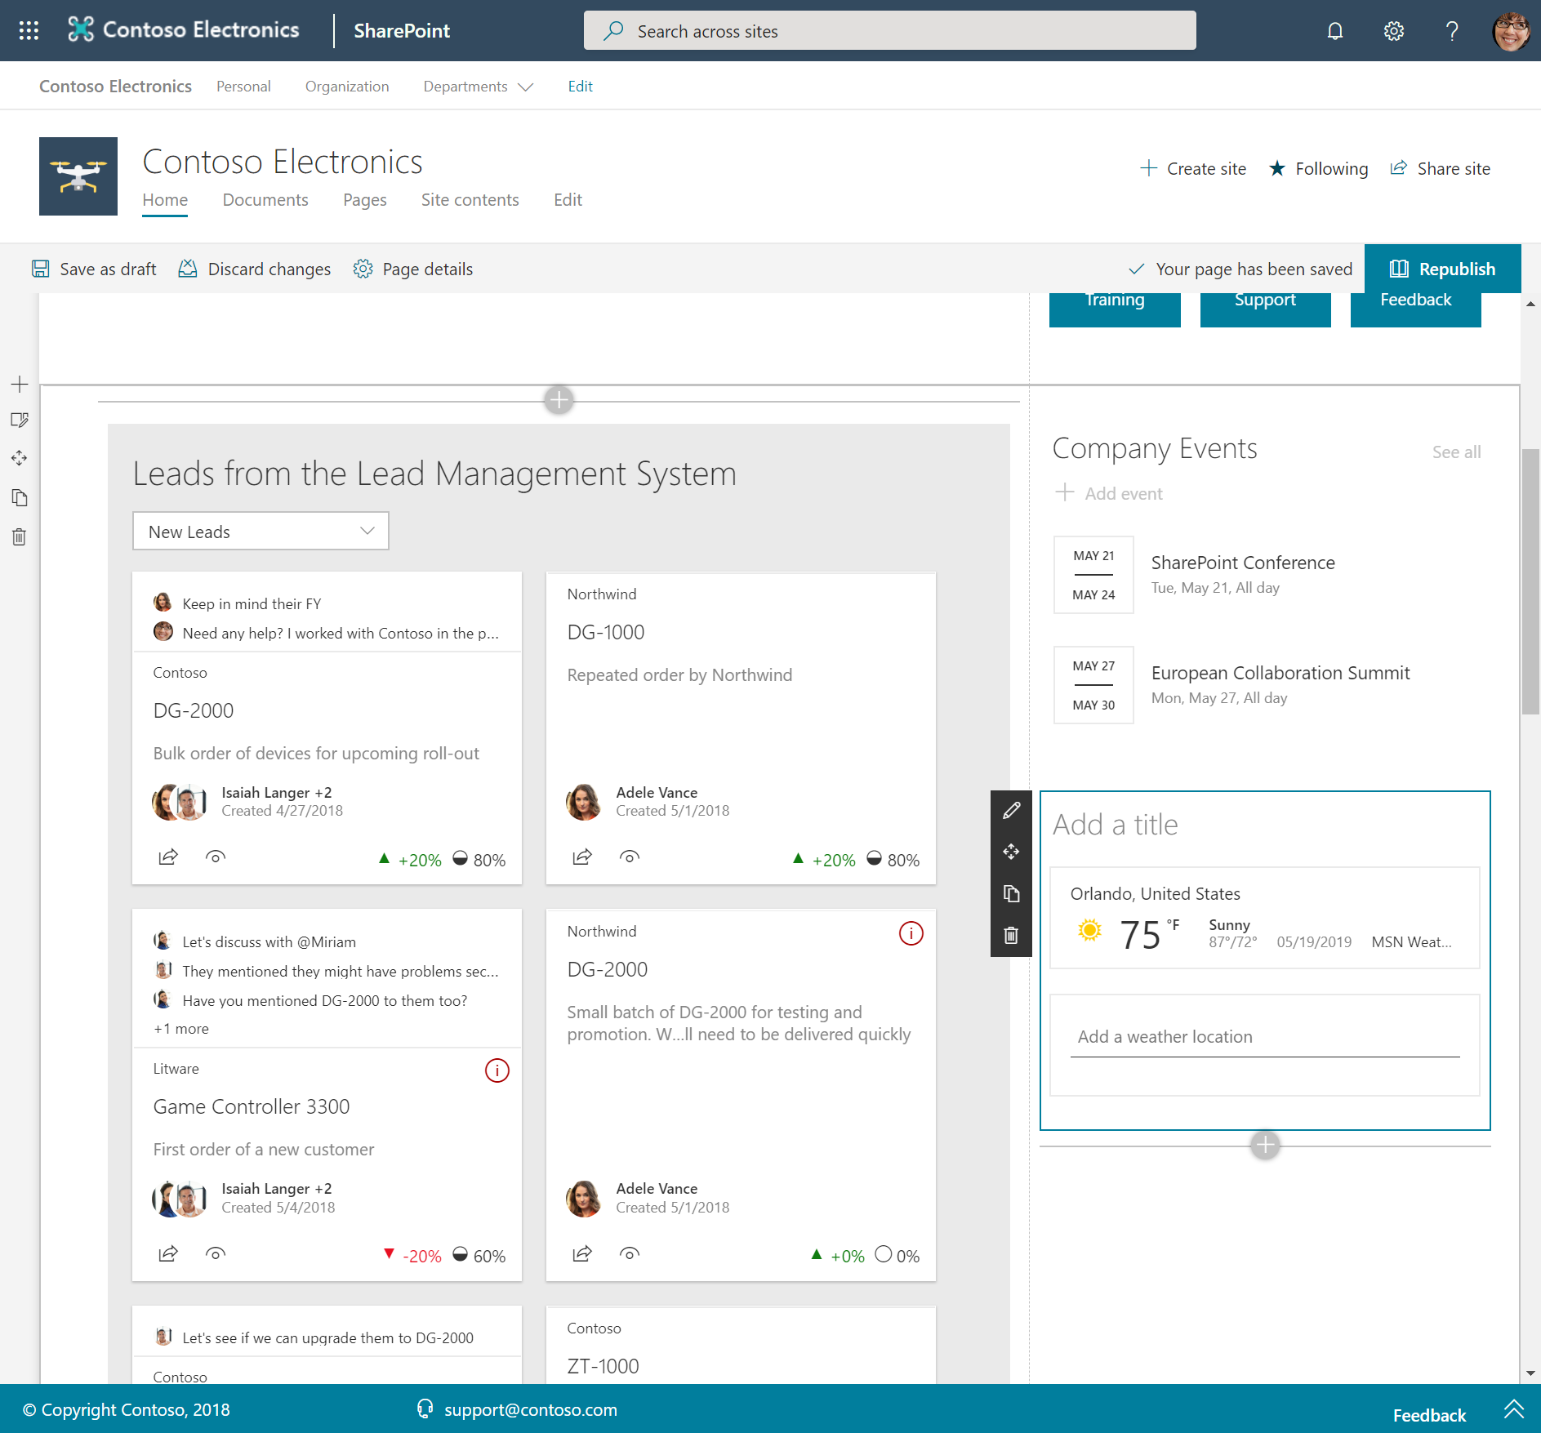
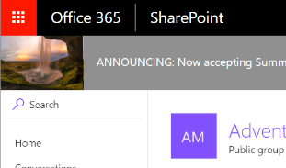
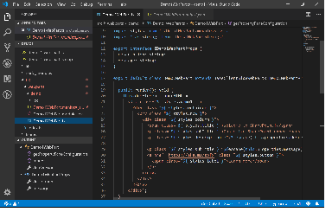
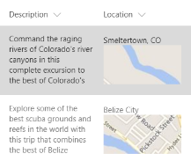
SharePoint Framework component types
Web Parts
Extensions
Libraries

Slide 11
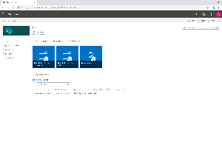
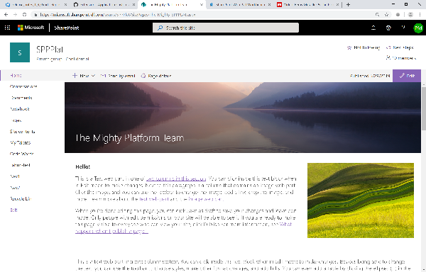
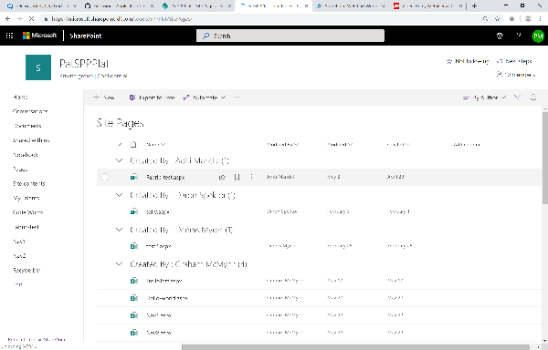
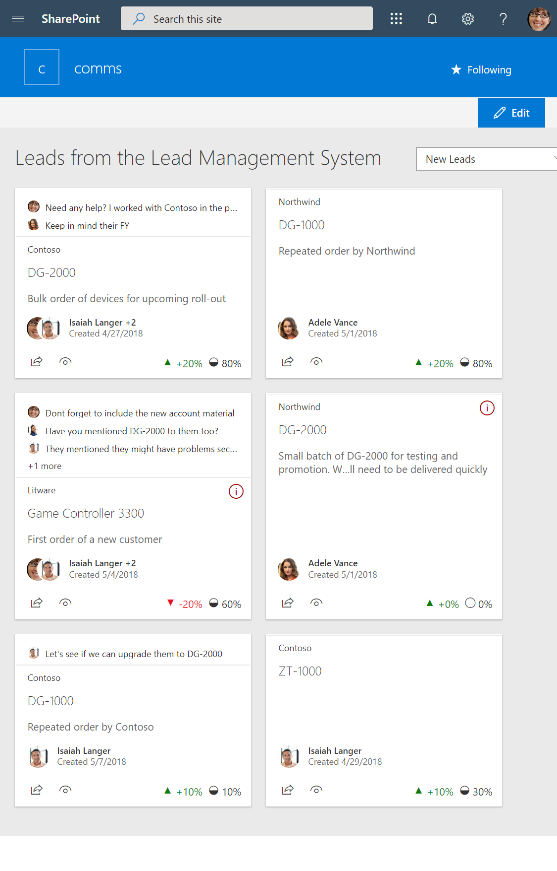
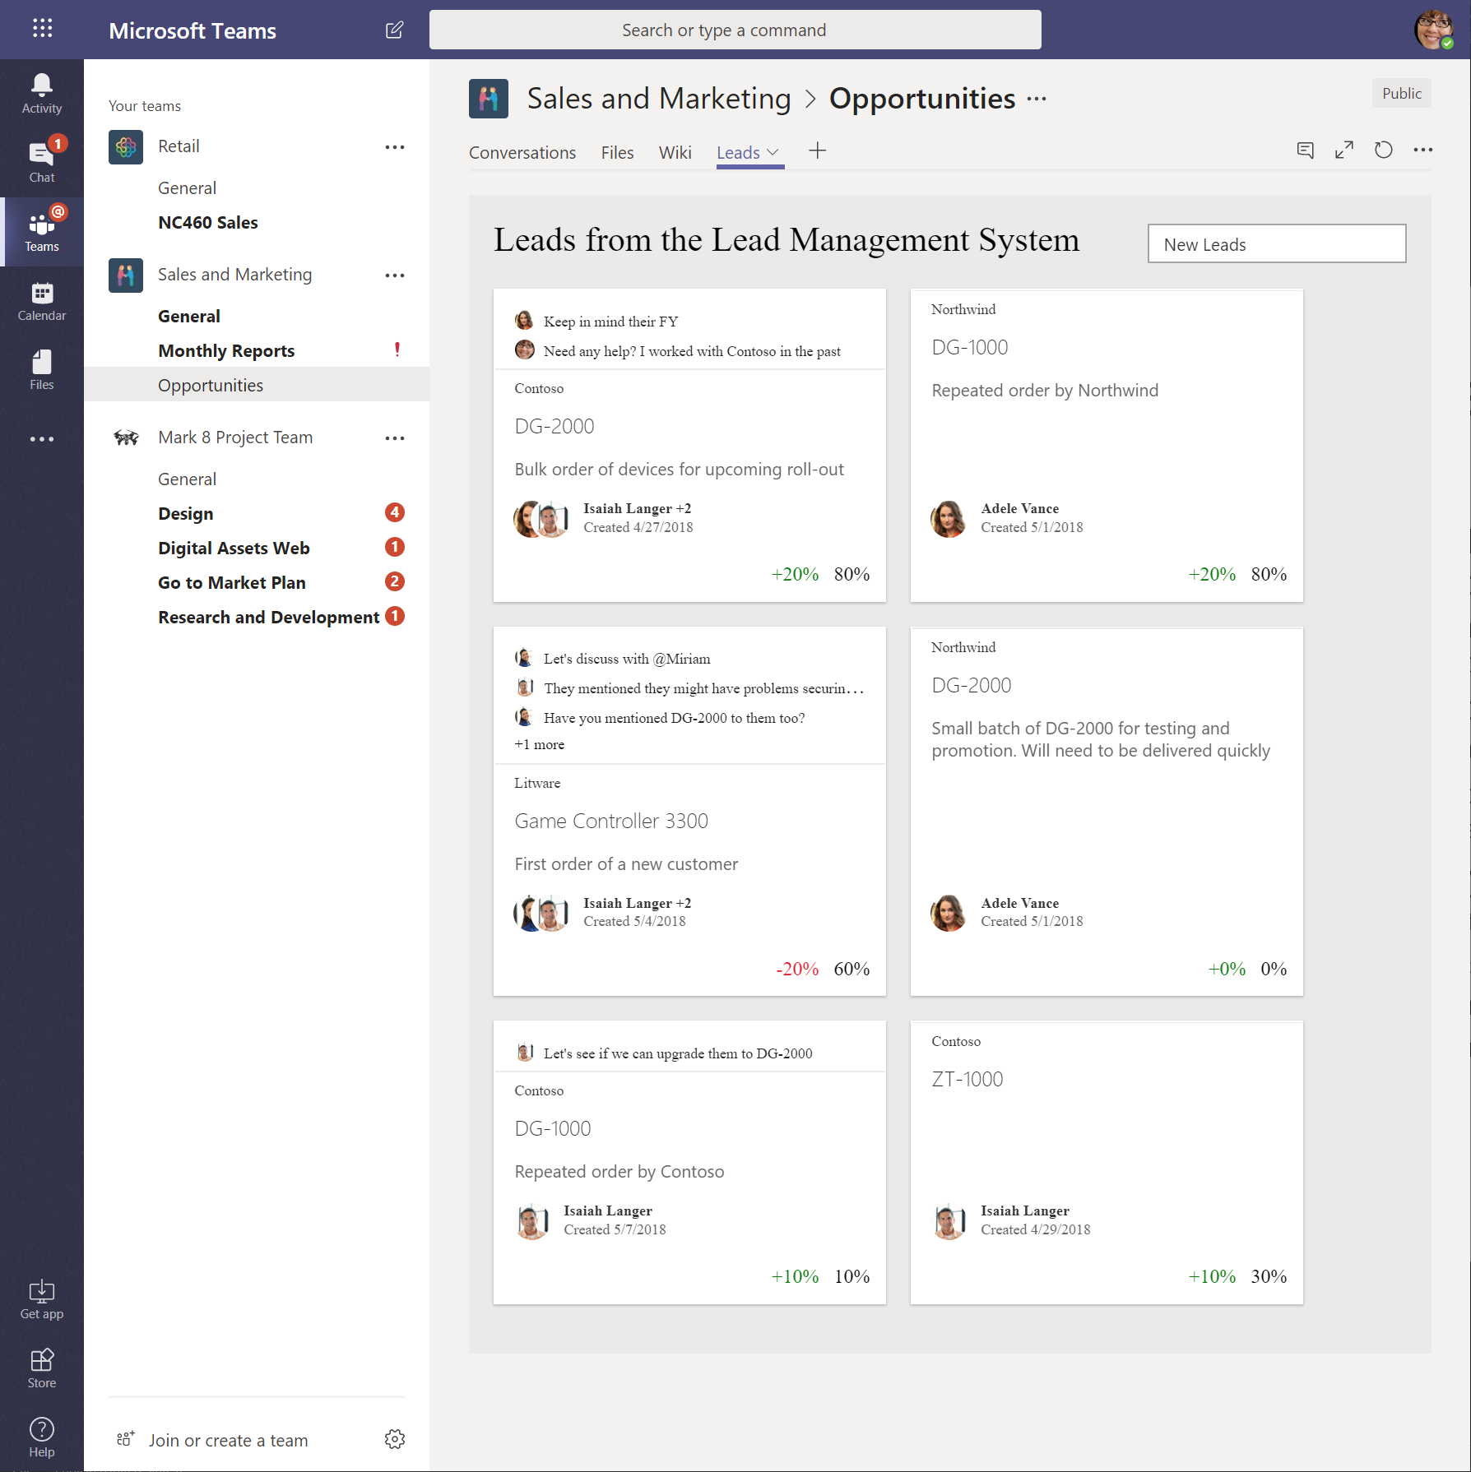
SharePoint Framework Hosted Scenarios
Classic Pages
Modern Pages
Lists and Libraries
App pages
Teams Tabs
Web Parts
Web Parts
Extensions
Web Parts
Web Parts
Extensions
Extensions
Library components work in all hosted platforms

Slide 12
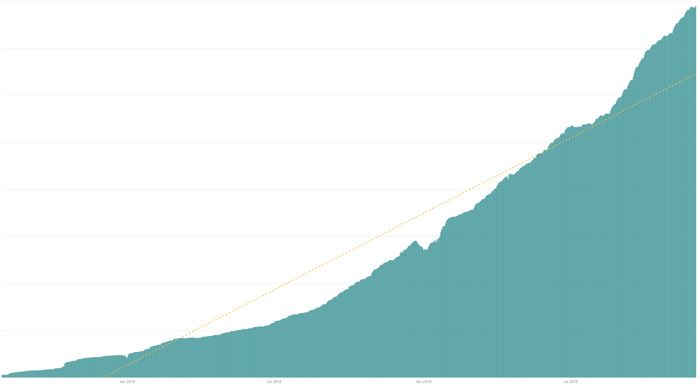
SharePoint Framework usage growth curve
Jan 2018
Jun 2018
Jan 2019
Jun 2019

Slide 13

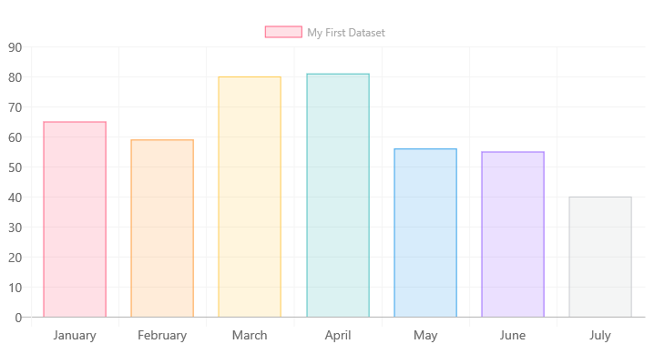
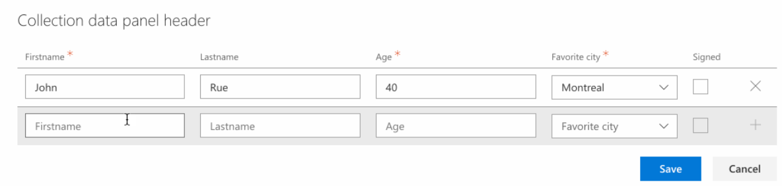

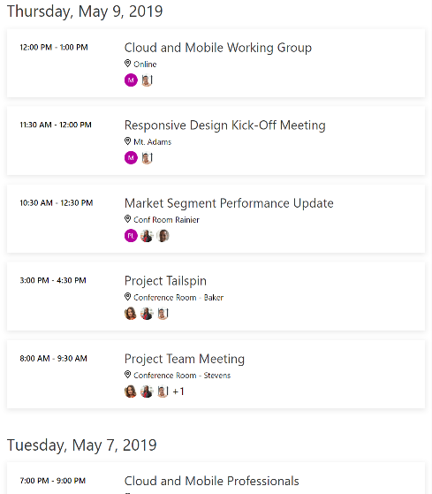
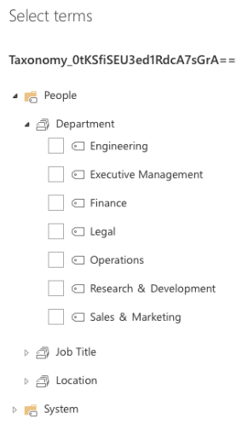
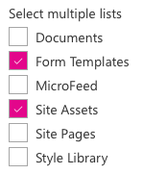
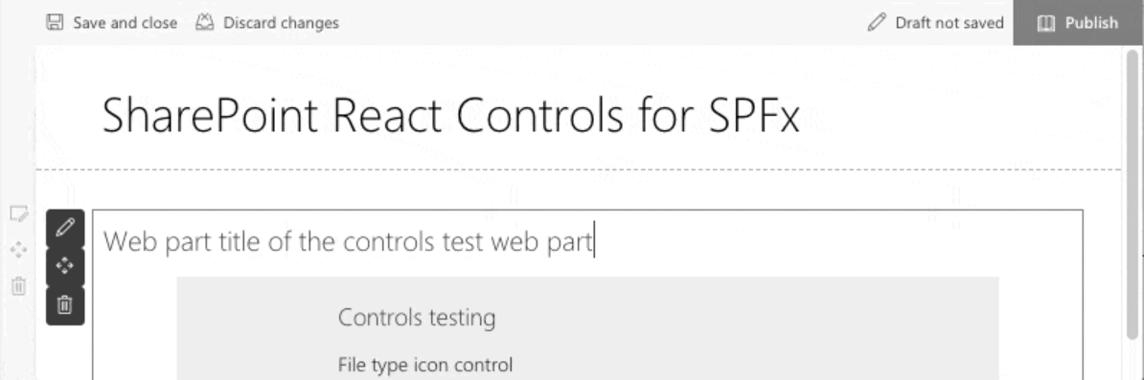
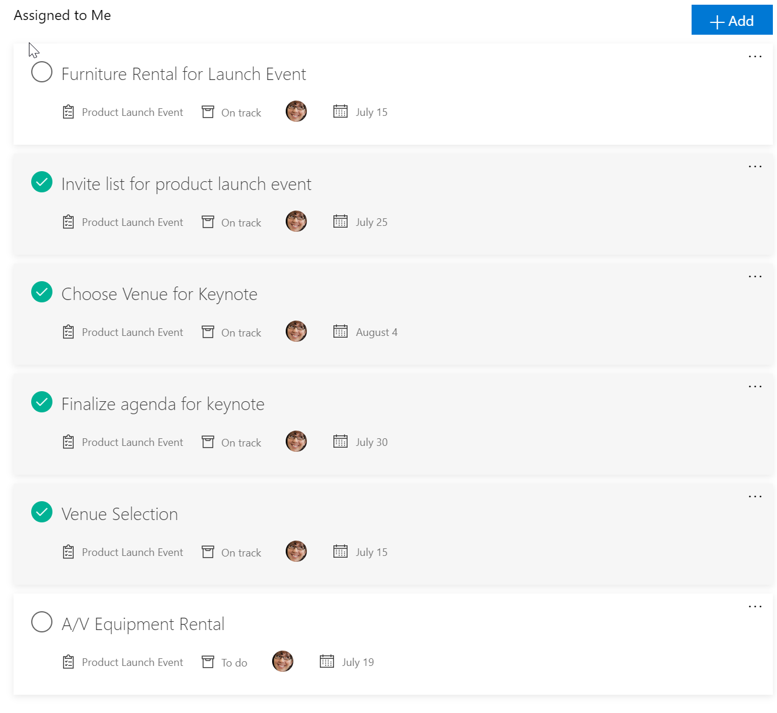
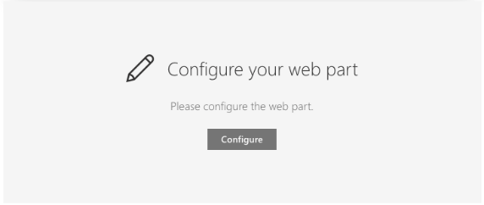
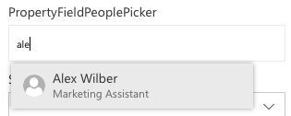
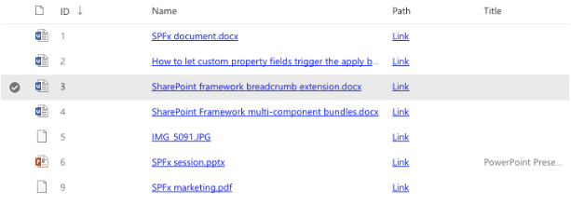
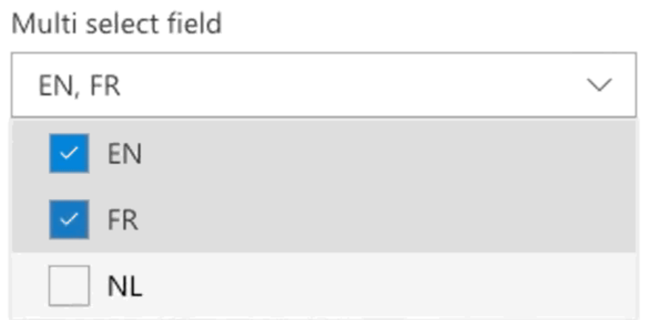
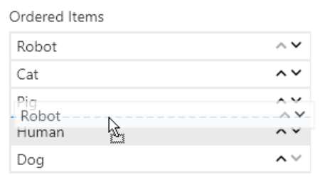
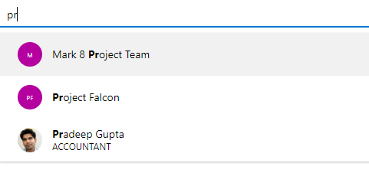
Reusable open-source controls to increase your productivity
React content controls
Use in the web parts and extensions
Property pane controls
Configuration options
Microsoft Graph Toolkit
Graph connected controls
sharepoint.github.io/sp-dev-fx-controls-react
sharepoint.github.io/sp-dev-fx-property-controls
aka.ms/mgt

Slide 14
What’s Coming in SharePoint Framework 1.10

Slide 15



SharePoint Framework 1.10 release – what’s included?
subject to change
New features to GA
Extensions: Pre-allocated placeholders
SPFx for Teams –personal apps support
SPFx for Teams – support for mobile app
List notification API moved to GA
Preview features in 1.10
New extension: Query Suggestions
SharePoint Framework for Office – support for Office add-ins (starts with OWA)

Slide 16
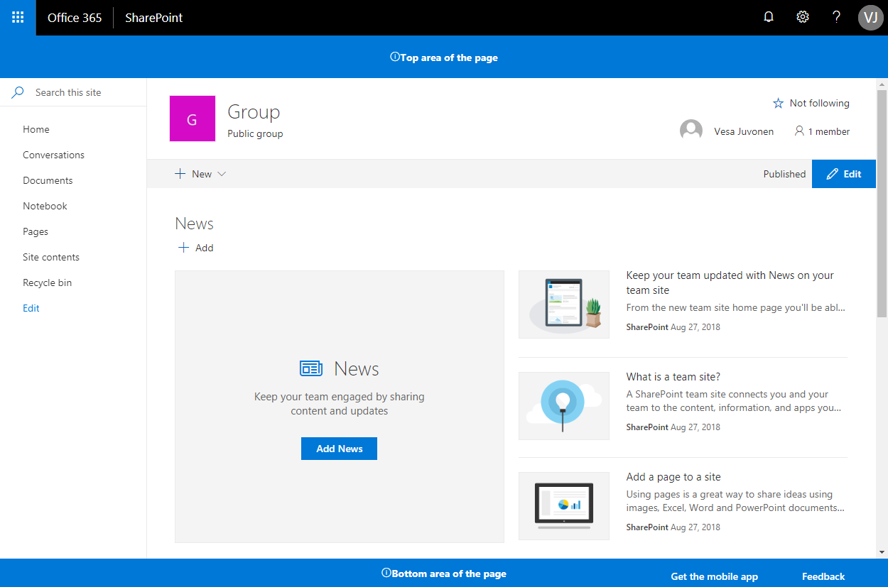
Pre-allocated extension sizes in page rendering
Site(s) accessed by end users
Tenant app catalog
Pre-allocated space
<<add>>
App catalog
js
TenantWideExtensions
SPFx solution
Pre-allocate div with specified size already on server-side rendering to avoid page flickering and movement after full page has been loaded.
You can define the pre-allocated sizes for each instance either from TenantWideExtensions list at app catalog or by using site specific CustomAction instance(s).
Pre-allocated space

Slide 17
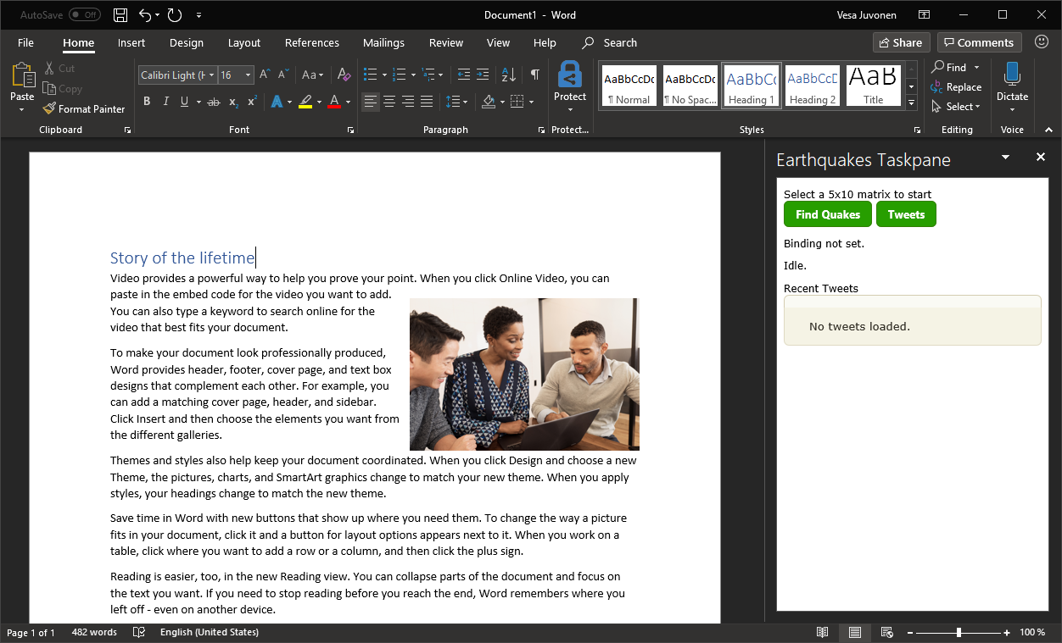
SharePoint as the hosting platform for Office add-ins – built with SharePoint Framework (name to be defined later xFx)
Office 365 public CDN
Objective: Simplify deployment and hosting for developers. Remove requirements for Azure AD specific apps or configurations through Azure Admin UI
js
JavaScript Library
SharePoint Online
3
All typical configuration available as for any SPFx solution – like asset packaging, CDN configuration, asset provisioning, native Microsoft Graph access with admin governance, custom 3rd party API access etc.
Office add-in built with SPFx
js
SPFx solution
Tenant App catalog
Office add-in application exposed in the Office product as a panel. JavaScript Solution Assets are hosted in SharePoint and published to Office clients using standard Office model. Only referenced URL for the manifest points to SharePoint.
js
SPFx Teams solutions are deployed to Office 365 tenants using tenant app catalog- Typical options for the sppkg file packaging and hosting available.
JavaScript Library
2
1

Slide 18
DEMO
1.10 features
Pre-allocated placeholders
Private tabs
Search extensibility
OWA add-in with SPFx

Slide 19
1.10 Feature Set Recap
Pre-allocated placeholders
Supported for both top and bottom placeholders
Doesn’t add additional delay in loading
Supported in existing extensions: manifest update is the only required change
SPFx for Teams –personal apps support
Supports all the SPFx capabilities: context information, access to Graph and other Web APIs, etc.
No configuration support
Same “sync to Teams” experience via SharePoint App Catalog
Supports admin management via app policies
SPFx for Teams – support for mobile app
SPFx based tabs supported in the native mobile app
Both for personal apps and channel tabs
Available with the November release of Teams Mobile app

Slide 20
1.10 Feature Set Recap
Search results extensibility: query modification
Add synonyms
Translation or additional intelligence
User roles/location
Custom business rules
Set up using PowerShell
Supported on the Search Results page
SPFx for Office – support for Office add-ins (starts with OWA)
Supports all the SPFx capabilities: context information, access to Graph and other Web APIs, etc.
Lifecycle controlled through the SharePoint App Catalog: full ALM support
Initial support for Outlook Web Access only for Developer Preview
Support for additional platforms in future interactions

Slide 21
The Road Ahead – SPFx vNext (aka xFx) and time after 1.10 release
ETA CY 2020
Native support for Fluid Framework
SPFx support in store (AppSource)
Unified toolchain for Microsoft 365 workloads
Faster inner dev loop
More extensions!

Slide 22
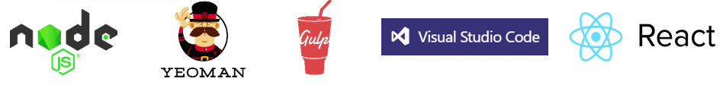
Extend SharePoint
Developer Tooling
SharePoint
Workbench
Web Parts
Web Parts
1
Enterprise Development Model - yo@MS/SharePoint | Hosting & Auth | Governance | Context
1
1
SP SDK
LOB Systems & Cloud Services
* = Preview

Slide 23
Extend SharePoint + Graph
Developer Tooling
SharePoint
Workbench
Web Parts
Web Parts
1
Enterprise Development Model - yo@MS/SharePoint | Hosting & Auth | Governance | Context
1
1
1
SP SDK
Microsoft Graph
LOB Systems & Cloud Services
* = Preview

Slide 24
Extend SharePoint + Graph + Teams
Developer Tooling
SharePoint
Workbench
Teams
Web Parts
Tabs
Web Parts
1
Enterprise Development Model - yo@MSSharePoint | Hosting & Auth | Governance | Context
1
1
1
SP | Teams SDKs
Microsoft Graph
LOB Systems & Cloud Services
* = Preview

Slide 25
Extend SharePoint + Graph + Teams + Office
Developer Tooling
SharePoint
Outlook
*Word / X / P
Workbench
Teams
Web Parts
Tabs
Addins
Addins
Web Parts
1
Enterprise Development Model - yo@MSSharePoint | Hosting & Auth | Governance | Context
1
1
SP | Teams | Office SDKs
Microsoft Graph
LOB Systems & Cloud Services
* = Preview

Slide 26
Microsoft 365 Platform - Ignite
Extend Microsoft 365 experiences
Developer Tooling
SharePoint
Outlook
*Word / X / P
Workbench
*Fluid Preview Canvas
Teams
Web Parts
Tabs
Addins
Addins
Web Parts
*Fluid objects
1
Enterprise Development Model - yo@Microsoft365 | Hosting & Auth | Governance | Context
1
1
1
1
*Fluid SDK
SP | Teams | Office SDKs
Microsoft Graph
LOB Systems & Cloud Services
* = Preview

Slide 27
In a Nutshell
SPFx capabilities evolve to seamlessly target more Microsoft 365 workloads
Unified toolchain experience to build SPFx web parts, Teams tabs, Office Add-ins, and *Fluid Preview Components
Supports all Microsoft 365 “canvases”
Provides canvas context at runtime
Hosting platform for enterprise extensibility
Access to Microsoft capabilities: Graph, Authentication, DDS, etc.
For Developers:
Common toolchain, codebase, manifest, package, & target multiple components (Web Part, Tab, Office Add-in, FPC)

Slide 28
DEMO
Fluid Framework and future Microsoft 365 components

Slide 29
Roadmap: SharePoint Developer platform
Available soon
Early next year
Top of mind
SharePoint Framework
Pre-allocated headers
Support for Teams personal apps
Support for Teams mobile app
Query Extensions (dev preview)
Support for Office add-ins in OWA (dev preview)
Fluid Components support (Private Preview)
Graph/API
Webhook support for Lists
Permission change support for Delta API
Followed Sites API (Dev Preview)
Check in \ Check out (Dev Preview)
SharePoint Framework
SPFx solutions in AppSource
GA of Query Extensions
Nav and header extensions (dev preview)
Graph/API
Site Discover\Enumeration API
File Requests Sharing API
Taxonomy API (dev preview)
Hub Analytics API (Dev Preview)
SharePoint Framework
Unified toolchain for Microsoft 365 workloads
Store story
Support for Fluid Components
Graph/API
CSOM on .NET Standard

Slide 30
Open-source and community

Slide 31

>500 samples
>1000
awarded
for helping to learn to extend Microsoft 365
Contributors in GitHub organizations
Internally at Microsoft as the reference model for community engagement
aka.ms/sppnp
>60000
>28000
>2.4 million
Visitors in GitHub organizations in past 2 weeks
Tenants using open-source components each month
Watch time minutes in the YouTube channel within last 365 days
fefe

Slide 32
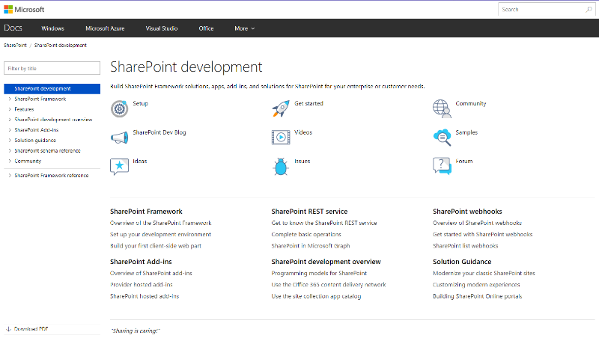
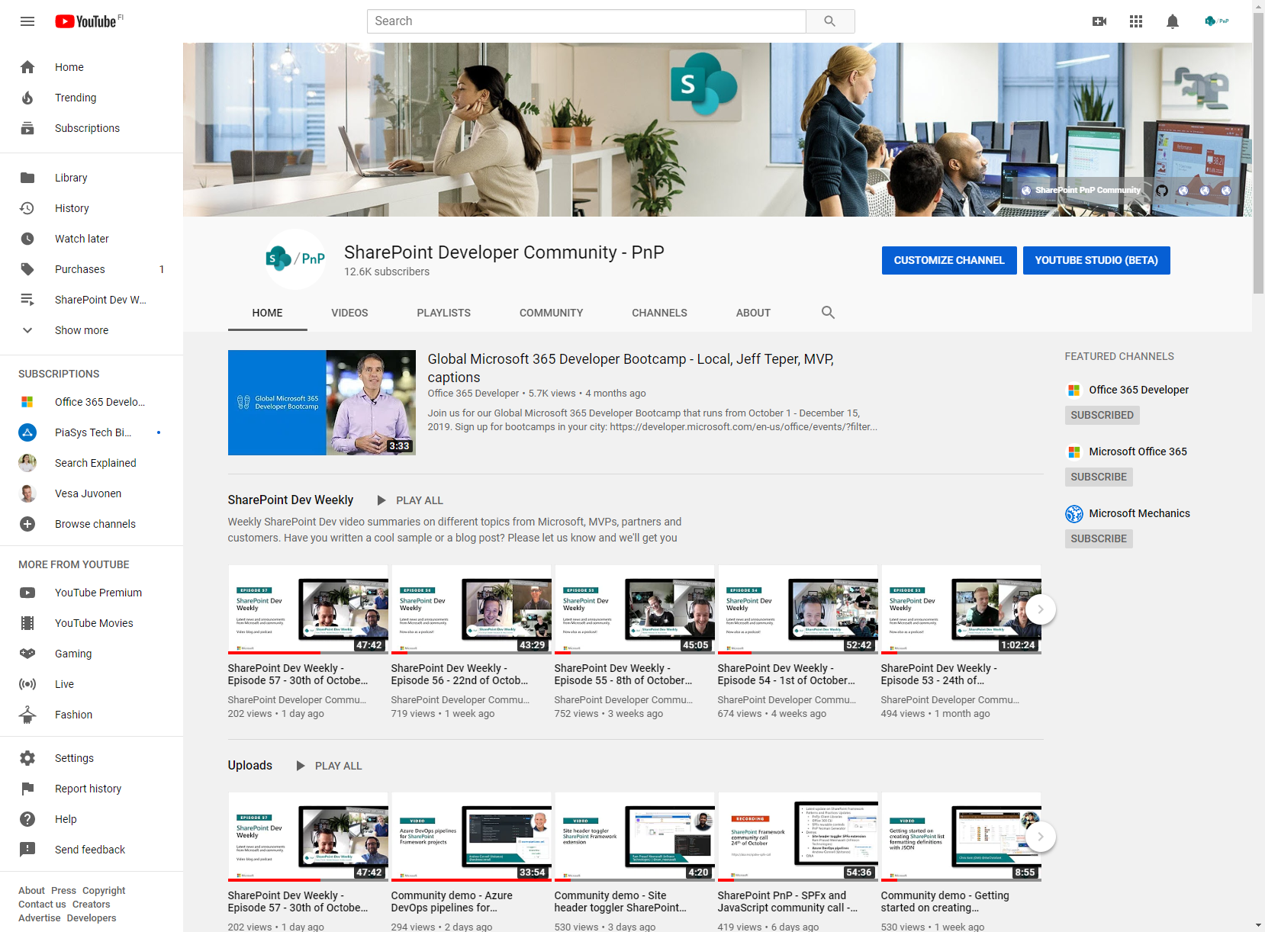
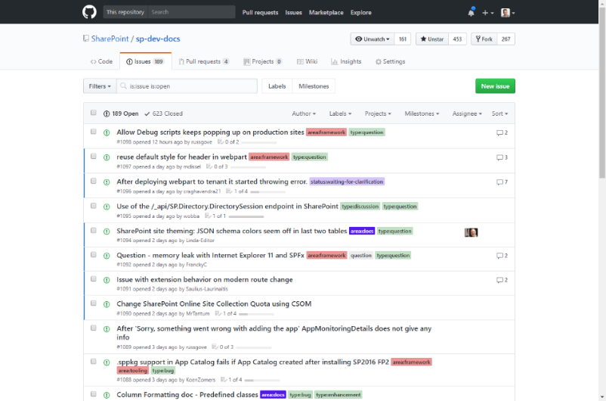
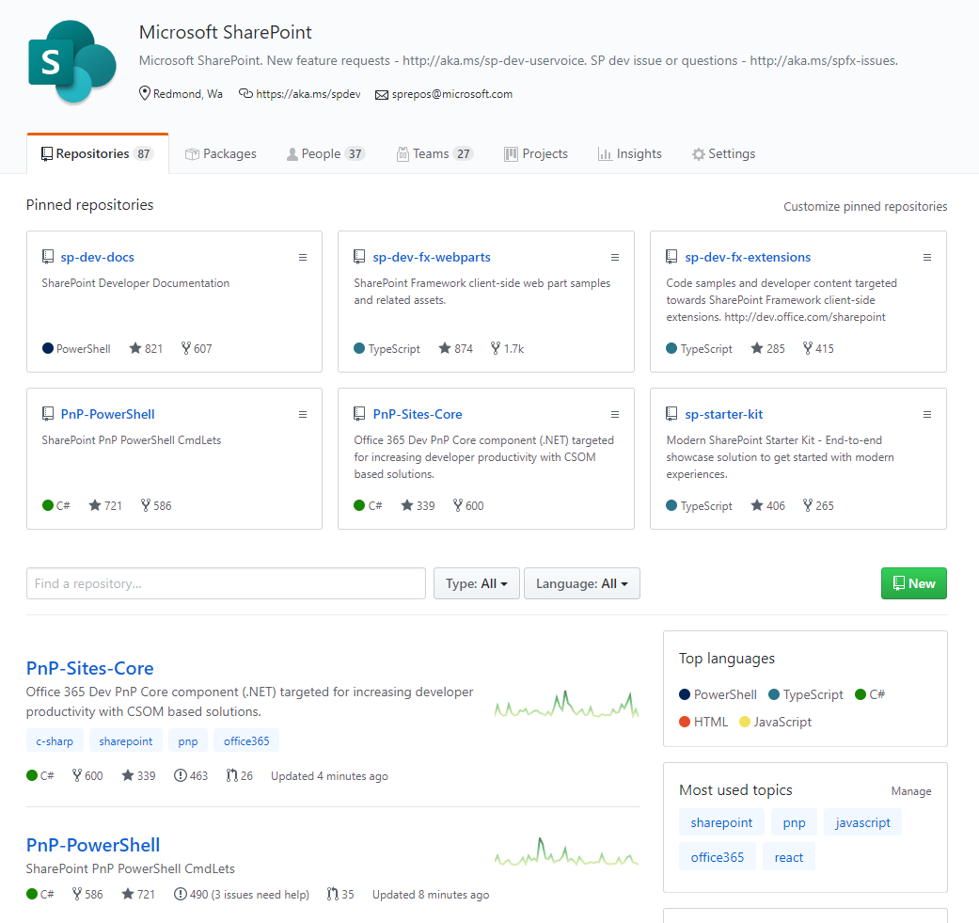
SharePoint Dev docs
SharePoint (Dev) videos
SharePoint Dev issues
Open-source
aka.ms/spdev-docs
aka.ms/spdev-videos
aka.ms/spdev-issues
github.com/sharepoint
github.com/pnp

Slide 33
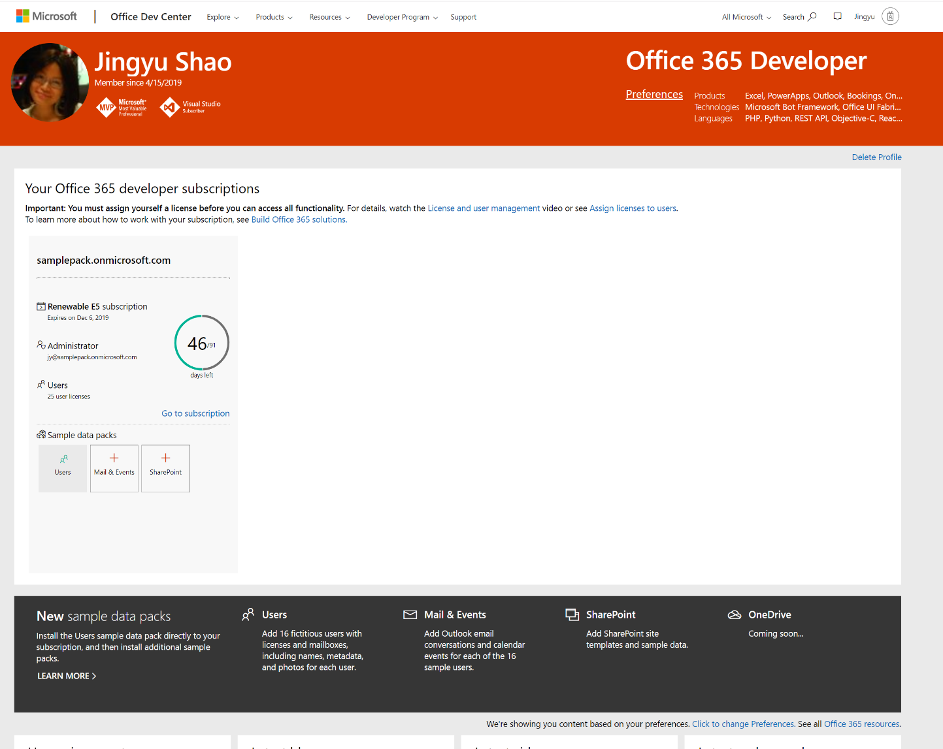
Join the Office 365 Developer Program!
https://aka.ms/IgniteO365DevProgram
New free renewable Microsoft 365 E5 subscription Be your own admin – auto-renew if used for dev purposes
New dev sandbox creation tools
Preload sample users and data for Microsoft Graph, and more
Access to Microsoft 365 experts
Join bootcamps and monthly community calls
Tools, training, and documentation
Learn, discover, and explore about Office 365 development
Blogs, newsletters, and social media
Stay up to date with the community

Slide 34
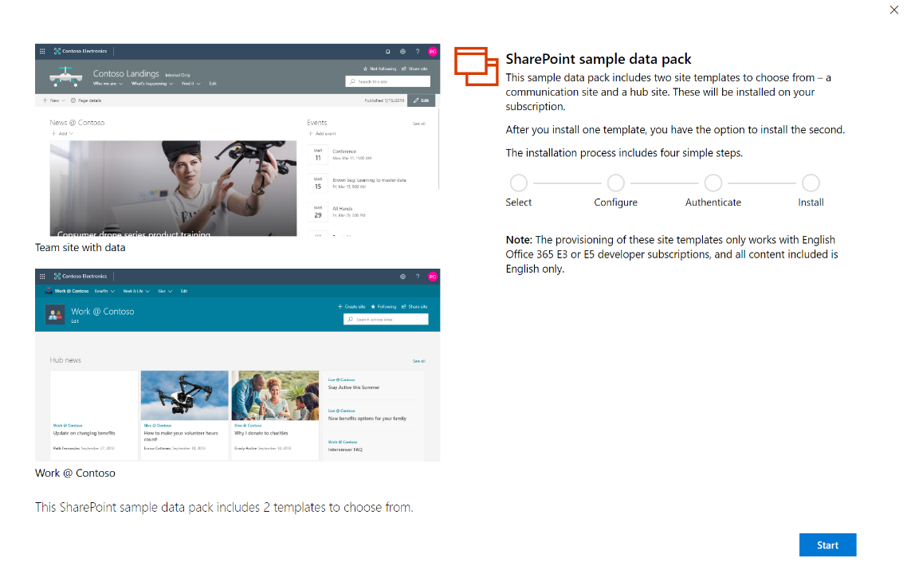
PREVIEW: New SharePoint Sample Data Pack What can I do with it?
Coming in Q1 2020
Explore SharePoint and Microsoft Graph Scenarios
SharePoint Framework Connect SPFx webpart to SharePoint
Build your first field customizer extension
PowerApps
Generate a canvas app in PowerApps from a SP list
Customize a SP list form using PowerApps
Microsoft Graph Scenarios
Enumerate the document libraries under the root site
SharePoint site based on relative path of the site
Search for a SharePoint site by keyword
Enumerate subsites of the root site
Enumerate site columns of the root site
Enumerate site content types of the root site
Enumerate the lists in the root site
Enumerate the list items in a list
Enumerate list items with specific column
Items trending around me
Items shared with me
Items uploaded by me (viewed and modified by me)

Slide 35


Thank you

Slide 36

Notes:
To add your image, first delete the place holder image as shown in the white box. Then insert your picture and scale it to be bigger than the size of the white box shown. Finally, right click on your image and select ‘Send to back’ – your image should now be framed correctly.

